Slide 1
Integrating COVID-19 claims into Compass

Slide 2
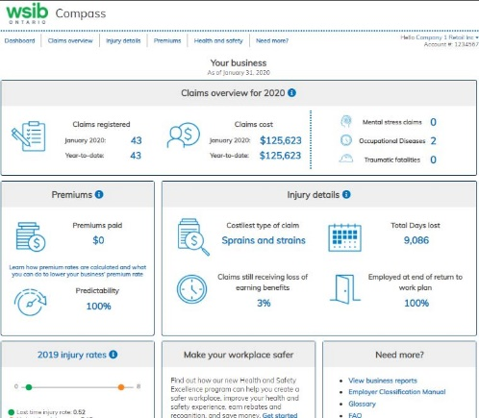
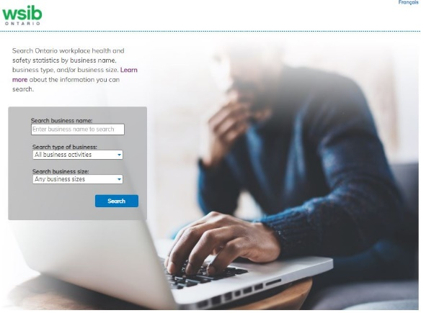
Compass Overview
Innovative and transparent online decision support tools that provides access to health and safety statistics for workplaces across Ontario
Compass
secure log-in tool for employers
provides businesses secure log-in access to their confidential, account specific information
NEW! interactive premium rate calculator to help businesses see the impact specific health and safety changes would have on their WSIB premium
Safety Check
open data tool for all Ontarians
find out how safe a business is and compare health and safety results of similar businesses

Slide 3
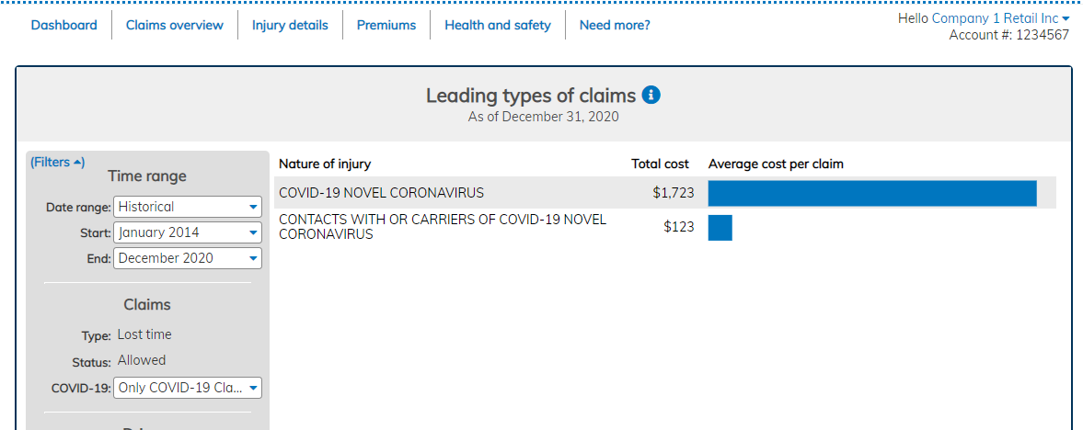
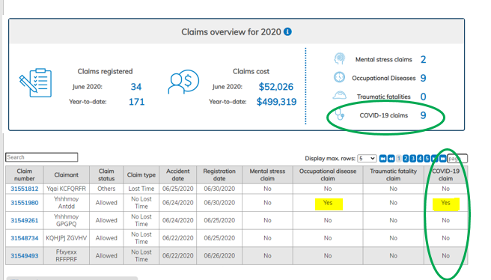
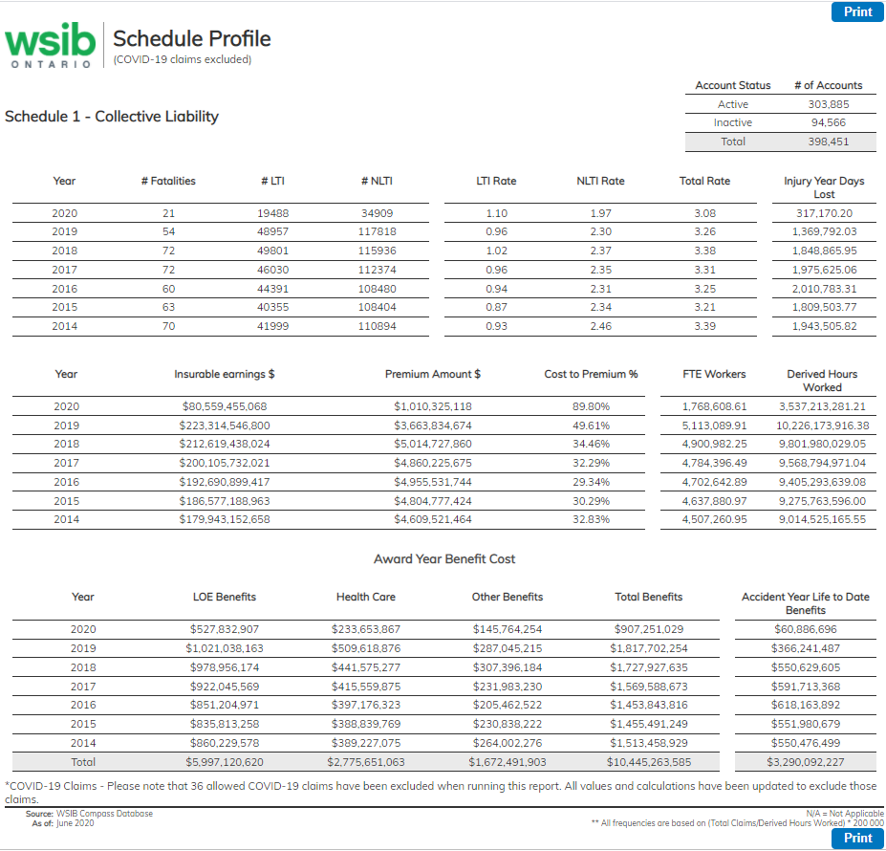
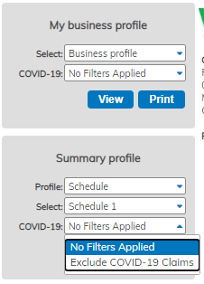
COVID-19 Claims in Compass
Compass enhancements
Compass (secure log-in) to include the following enhancements:
COVID-19 count on main page dashboard under COVID-19 claims
Claims registered, cost and injury graph includes option to filter out or include COVID-19 claims
Downloadable data includes a COVID-19 indicator
Profile reports (both public and full version) provides ability to filter out COVID-19 claims with appropriate notations
Figure C

